Slide 1
Input = 20 x 3
Network = 10 x 10 x 3
1
2
3
.
.
.
.
20
1 | 2 | 3 | . | . | . | . | 100

Slide 2
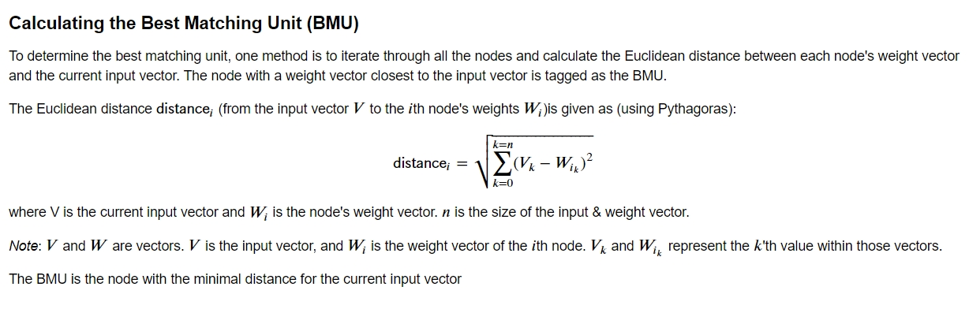
Input = 20 x 3
Network = 10 x 10 x 3 = 100 x 3
1
Choose the closest node for each input
Update the closest & neighbour node’s weights
2
1
3
2
3
20
100

Slide 3
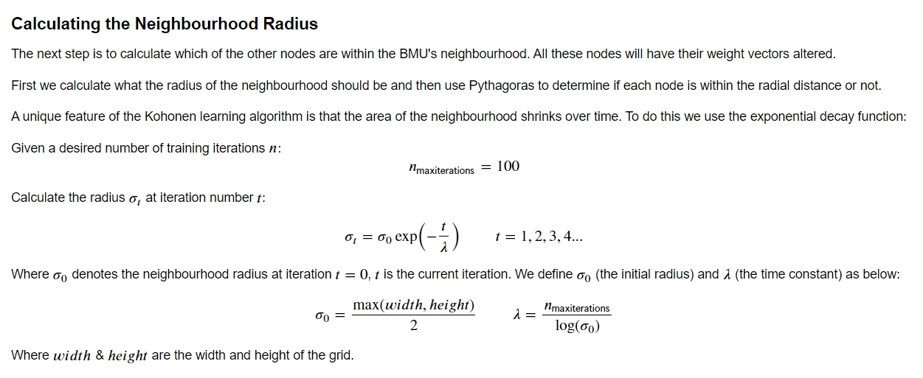
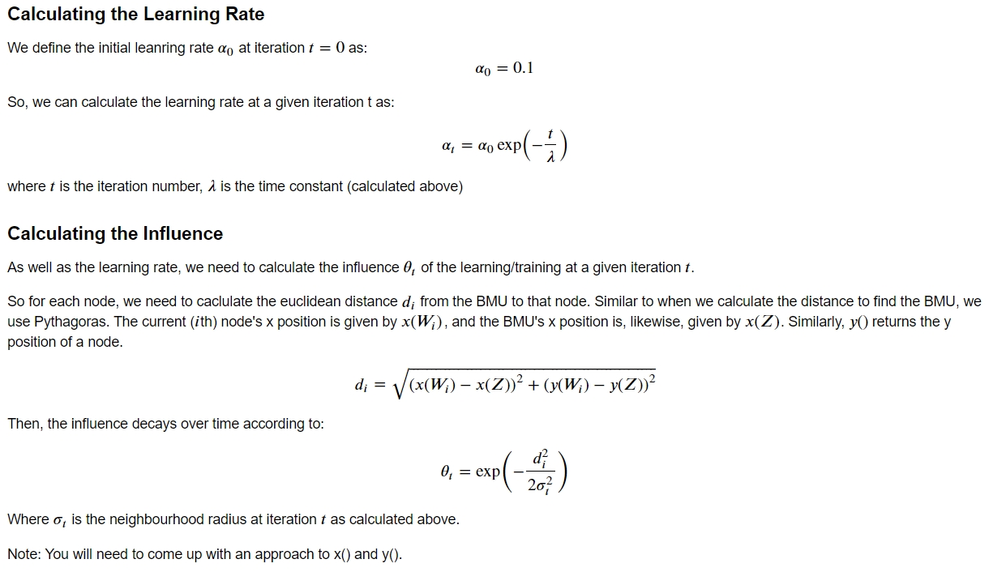
 |  |  | bmuY - radius
 | bmuX - radius |  | (bmuX, bmuY) |  | bmuX + radius
 |  |  | bmuY + radius
How to choose neighbour nodes

Slide 4
def WithinRadius(self, bmuX, bmuY, bmuNode, radius):
### Travel neighbours inside the radius scope
### Instead of calculating specific distance,
### this function treats the diagonal neighbours as distance 1
Approximation > might cause poor performance
However, the main idea is updating neighbours and the scope gets smaller as the iterations proceed

Slide 5
Design Decision Mistake -> chose (m x n) x 3 instead of m x n x 3
Reason : did not consider Radius
Would have done : m x n x 3 => code would be much clean and efficient

Slide 6
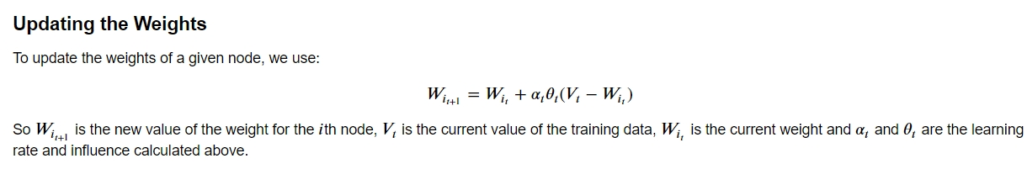

Slide 7
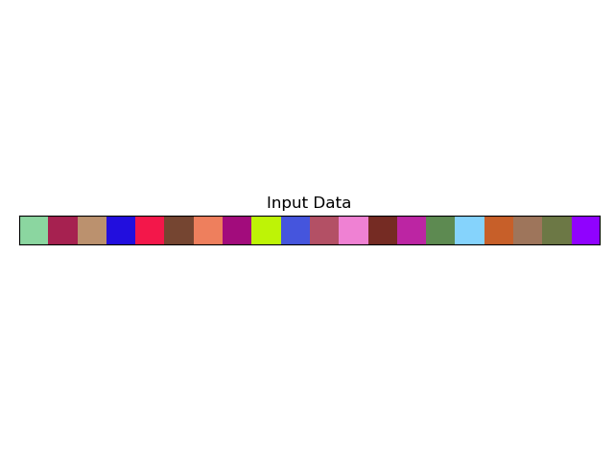
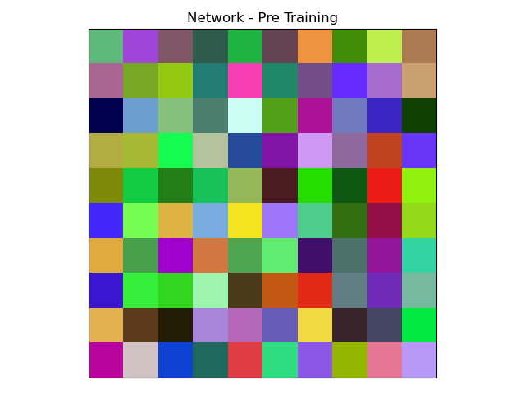
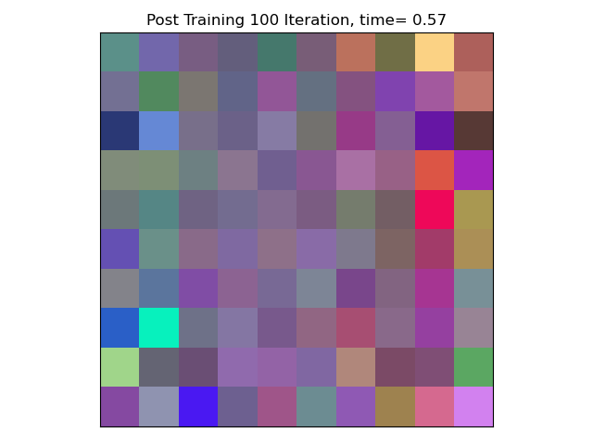
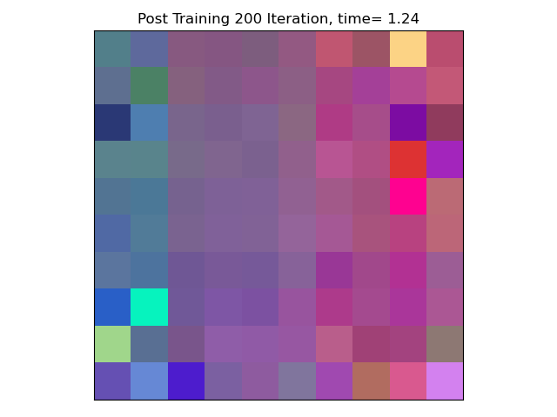
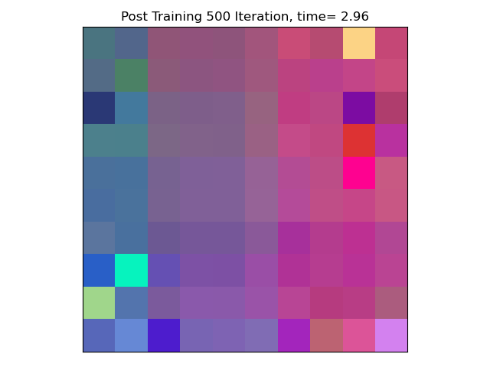
Result

Slide 8
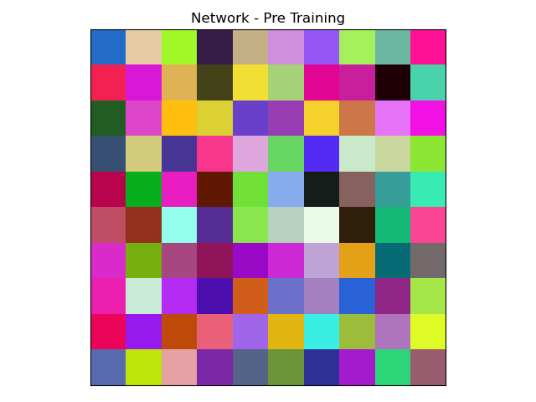
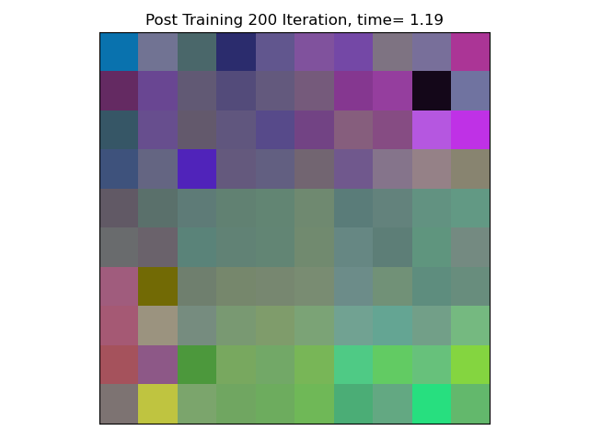
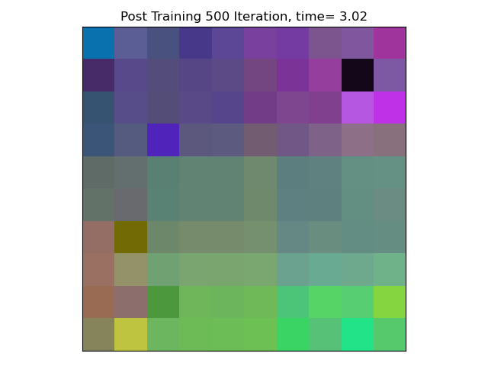
Result

Slide 9
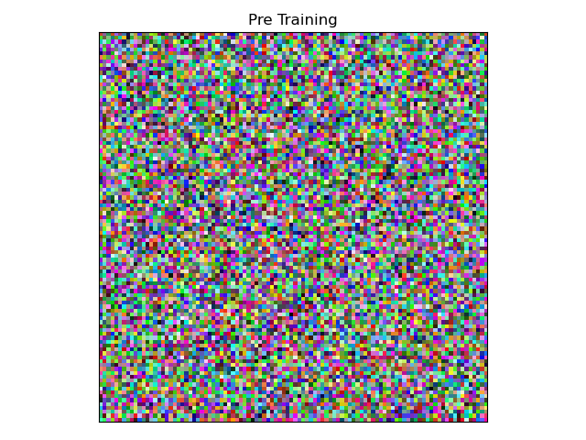
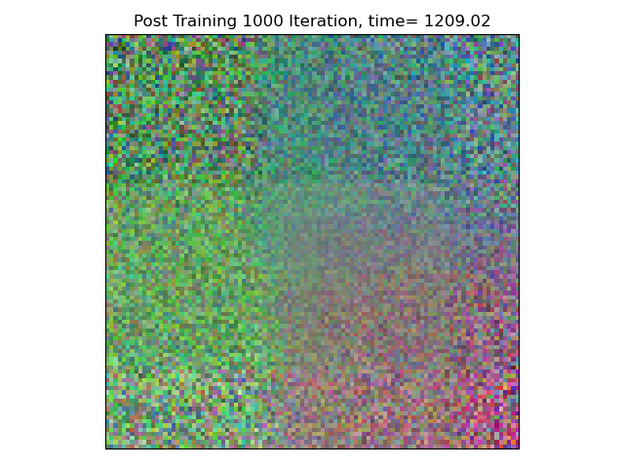
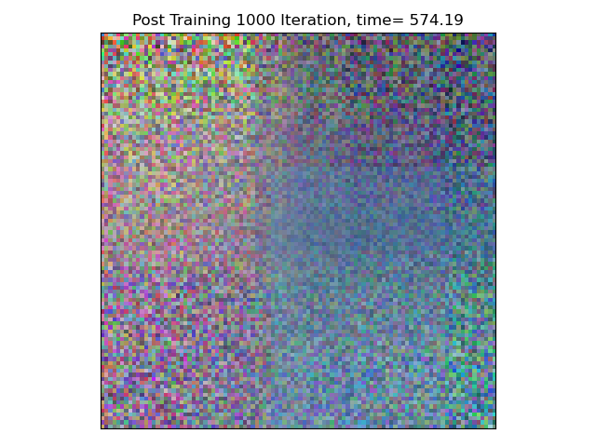
Result

Slide 10
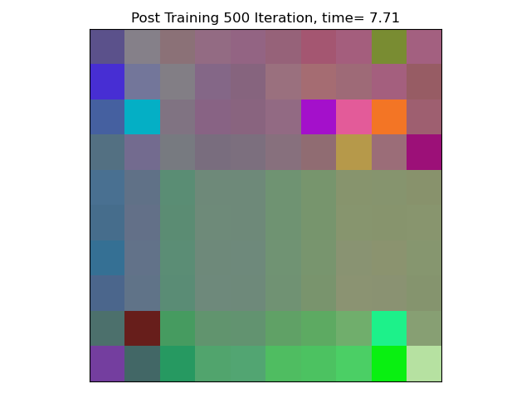
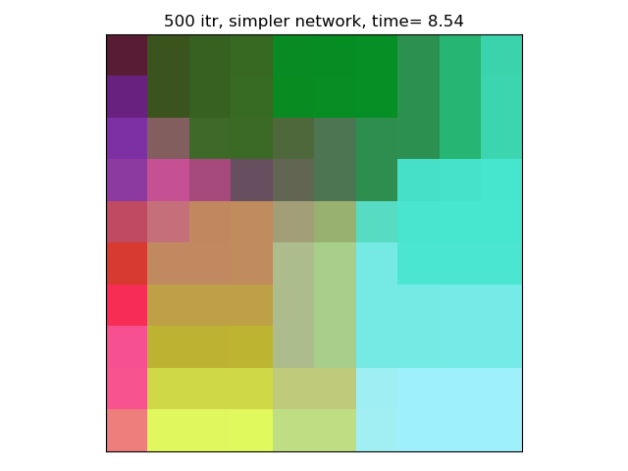
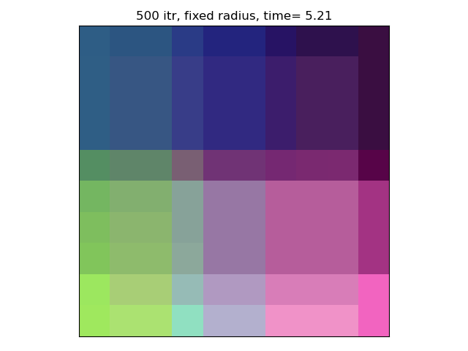
Parameter Decaying Rate
Notes:
Lager radius val => Less impact
Small & fixed radius => distinct, definite impact

Slide 11
Parameter Decaying Rate
Fixed Radius
Simpler Radius Decaying
(Smaller range)
Fixed Radius
# Calculate Radius radius_init = max(self.m, self.n) / 2 llambda = self.T / math.log(radius_init) self.radius = radius_init * math.exp(-1*t*llambda) # Calculate Learning Rate alpha = self.alpha * math.exp(-1 * t /llambda)
if t < T/3: self.radius = self.m / 2 elif t < 2*T/3: self.radius = self.m / 3 else: self.radius = self.m / 10 # Calculate Learning Rate alpha = self.alpha * 1/6
radius_init = 3 self.radius = radius_init llambda = self.T / math.log(radius_init) # Calculate Learning Rate alpha = self.alpha * 1/6

